Slide 1


Team T02
May 11th, 2021
Tanner Evans (team manager)
Thomas Bowidowicz (document manager)
Robin Acosta
Jared Bock
Marcos Lopez
Jacob Varela
Notes:
This is a sample Title Slide with Picture ideal for including a picture with a brief title and subtitle.
1

Slide 2
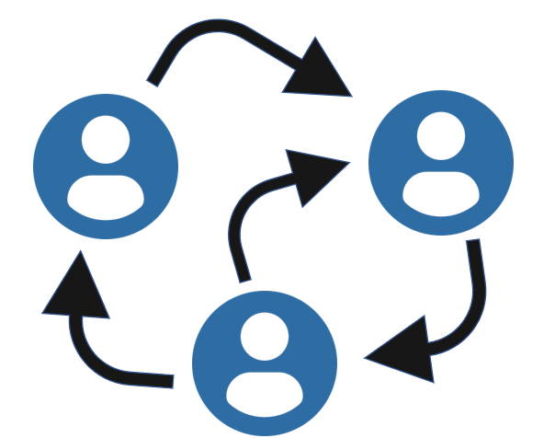

System Architecture Design Choices
Actor Model
Actor model sees each actor being functional as its own independent subsystem.
Actors can send and and receive messages and choose how to respond to the input locally.
Allows for asynchronous communication.
Modular Subclassing
Superclass can be defined with the majority of the universal functionality while subclasses can define their specific requirements.
Allows for modularity of design and easy additions or removals of components to the system.
Superclass Component is extended by all subclasses defines the general outline for all components.
Notes:
2
This is a sample Two Pictures with Captions slide ideal for including two pictures with brief descriptive statements.
To Replace the Pictures on this Sample Slide (this applies to all slides in this template that contain replaceable pictures)
Select the sample picture and press Delete. Click the icon inside the shape to open the Insert Picture dialog box. Navigate to the location where the picture is stored, select desired picture and click on the Insert button to fit the image proportionally within the shape.
Note: Do not right-click the image to change the picture inside the picture placeholder. This will change the frame size of the picture placeholder. Instead, follow the steps outlined above.
Tip: use the Crop tool to reposition a picture within a placeholder. From the Picture Tools Format tab on the ribbon, click the Crop button. Click and drag the picture within the placeholder to reposition. To scale the picture within the placeholder (while Crop is active), grab a round corner handle and drag to resize. Hold Shift key to constrain picture aspect ratio when resizing.

Slide 3
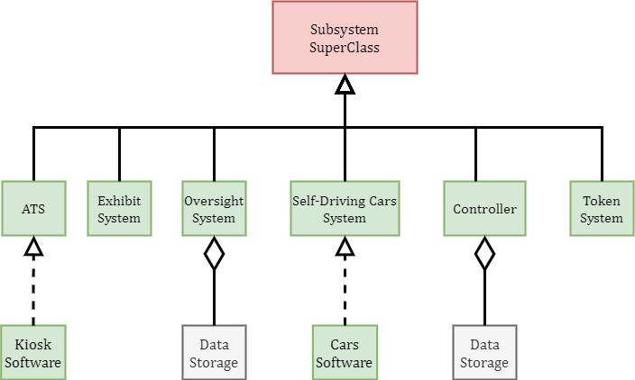
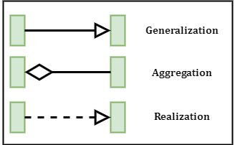
Class Diagram
Legend

Slide 4
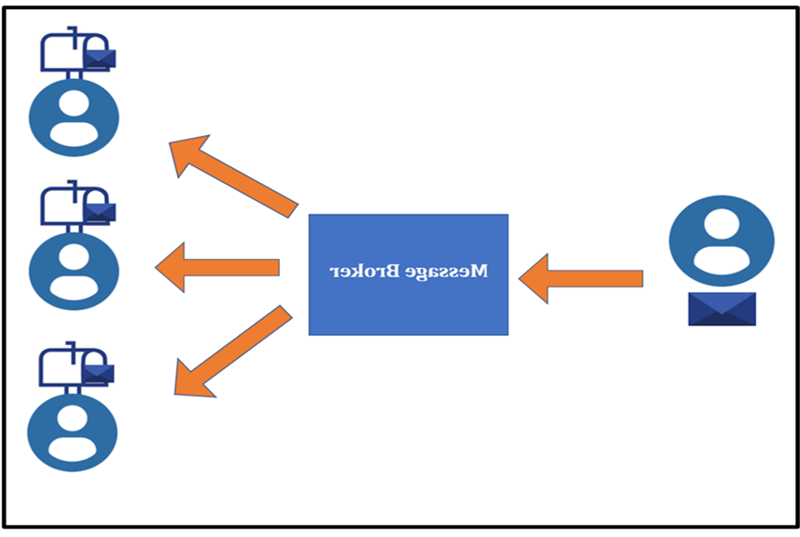
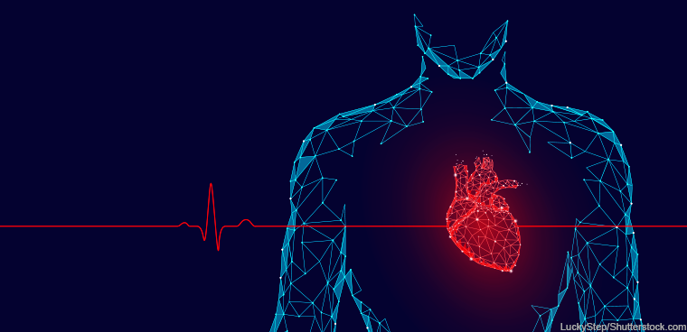
System Architecture Design Choices Continued…
Message Broker
Message broker mediates various messages from range of components while they have minimal awareness of each other.
Predefined messages are sent from components to broker and placed on a message queue before being delivered to destination.
Allows for asynchronous communication between components.
Heartbeat Signals
Used for notifying controller that devices are operating normally.
Periodic notification sent to indicate normal function.
If signal stops, it indicates a malfunction or break in the device.
Notes:
4
This is a sample Two Pictures with Captions slide ideal for including two pictures with brief descriptive statements.
To Replace the Pictures on this Sample Slide (this applies to all slides in this template that contain replaceable pictures)
Select the sample picture and press Delete. Click the icon inside the shape to open the Insert Picture dialog box. Navigate to the location where the picture is stored, select desired picture and click on the Insert button to fit the image proportionally within the shape.
Note: Do not right-click the image to change the picture inside the picture placeholder. This will change the frame size of the picture placeholder. Instead, follow the steps outlined above.
Tip: use the Crop tool to reposition a picture within a placeholder. From the Picture Tools Format tab on the ribbon, click the Crop button. Click and drag the picture within the placeholder to reposition. To scale the picture within the placeholder (while Crop is active), grab a round corner handle and drag to resize. Hold Shift key to constrain picture aspect ratio when resizing.

Slide 5
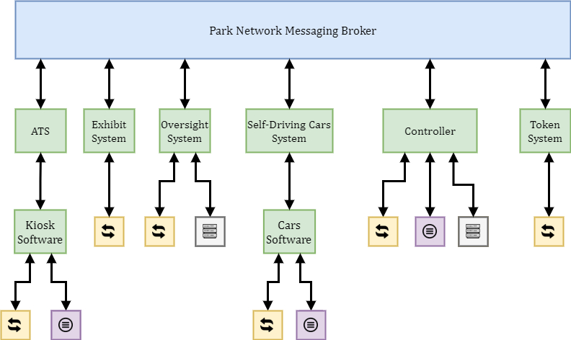
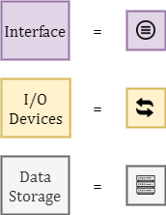
System Architecture
Legend

Slide 6
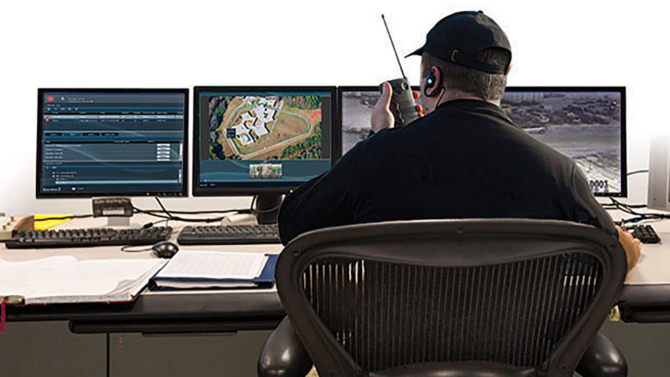
Components – Siesta Gardens Controller (SGC)
Serves as main controller for park subsystems.
Comprised of server for the park network and client GUI.
Is the primary destination for subcomponent messages containing data.
GUI allows for park administrators to look at current status of park and to respond to any issues.
Receives messages and data through the message broker from the following subcomponents:
Token Monitoring System
Oversight System
Exhibit System
Self Driving Car System
Automated Ticket System

Slide 7
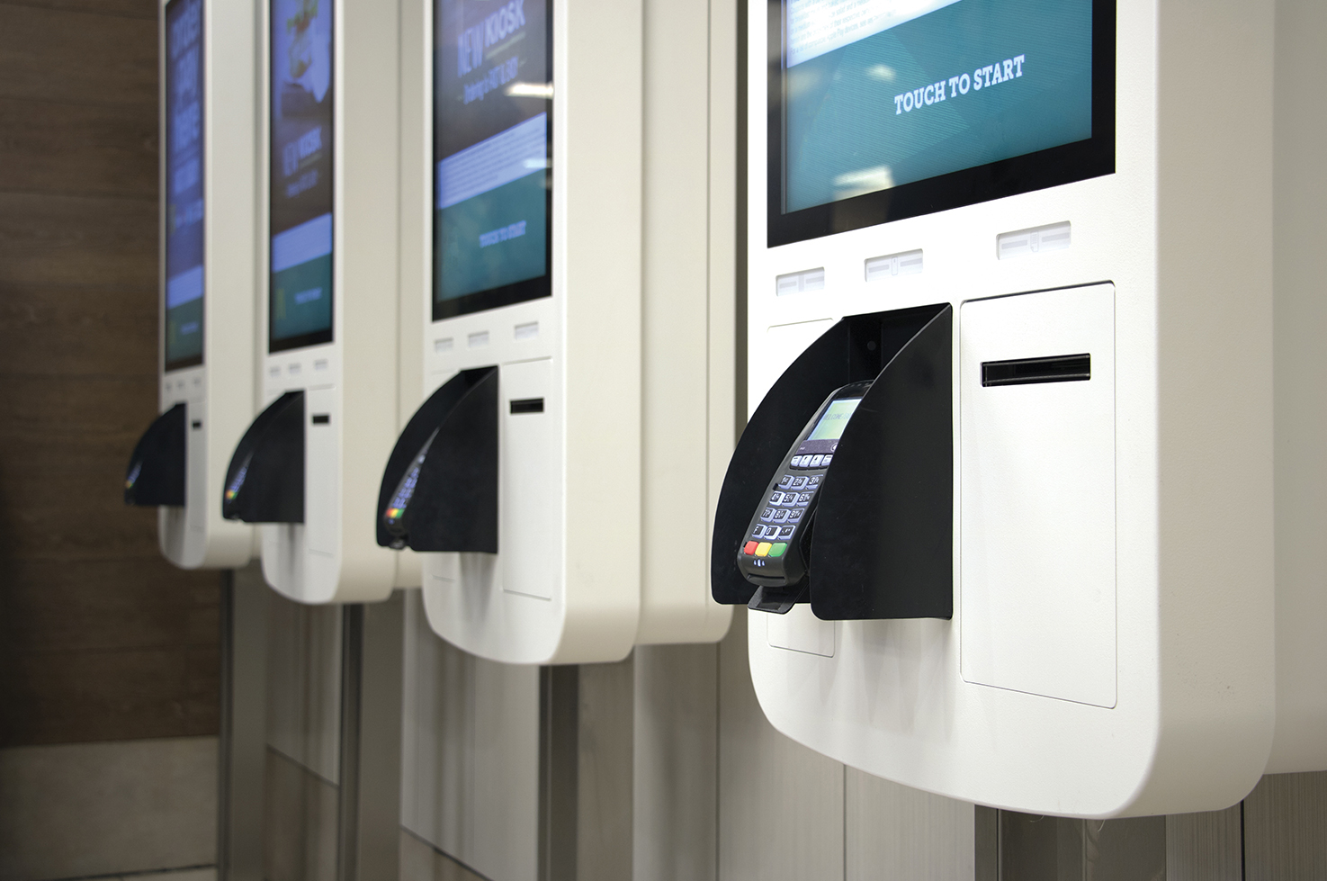
Components – Automated Ticket System (ATS)
Contains Kiosk GUI that allows customers of the park to agree to waiver, submit payment information, and be verified for park access.
Kiosk GUI sends information to ATS to verify payment.
Once verified, a Person object is created to store customer information.
ATS sends customer information to SGC.
SGC can shutdown kiosks in case of emergency.

Slide 8
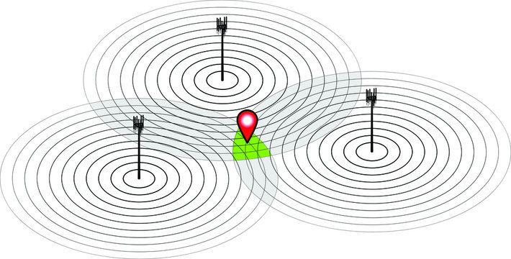
Components – Token Monitoring System
Monitors the location of each active token in the park.
Uses RFID Pylons throughout the park to track the Tokens given to each Visitor.
Tokens are physical pieces of hardware with a RFID Chip inside them.
Tokens are logged into the Token Monitoring System with its unique ID, Visitor Info, and its location.
Location is updated as the RFID chips are read by the Pylons and then translated into X and Y coordinates.
Maintains the generation and removal of new token IDs.

Slide 9

Components –Self Driving Car System
System integrates data received from the self driving sensors on the cars.
System checks to see if there are any obstructions and notifies the SGC through the message broker if there are any.
Checks list of in use tokens and only allows those those passengers on.
Manages all of the signals that can be sent from the SGC including shutdown signal that can be activated in case of emergency.

Slide 10
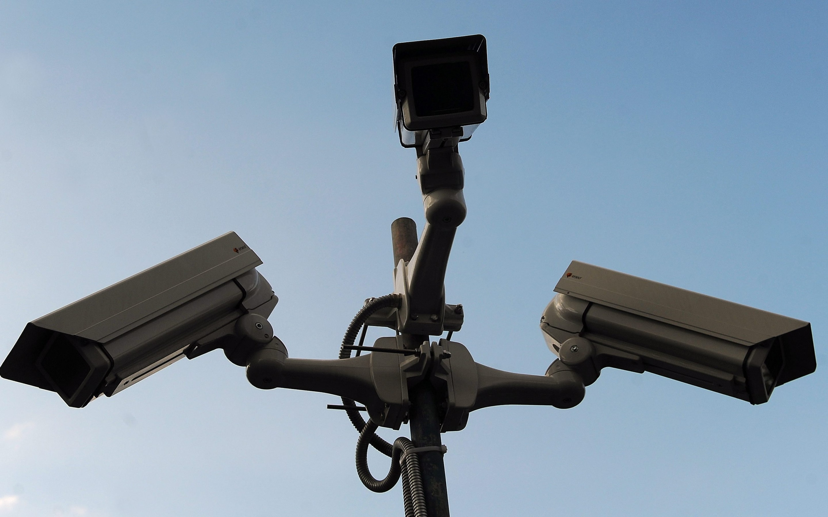
Components – Oversight System
Serves as a means of communication with the SGC and as a way to directly monitor video feeds and alarm systems.
GUI allows guard stations throughout the park to monitor the live feed from various cameras around the park and the general status of the alarms.
Camera feeds use a Stream to provide constant data to the SGC.
Defines the reactions to commands coming in from the message broker.

Slide 11
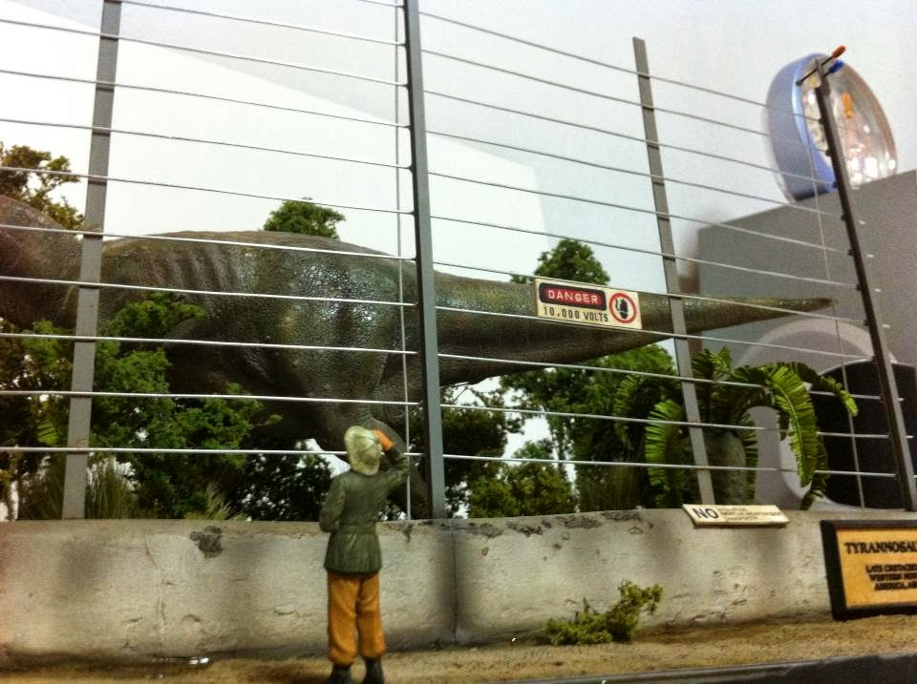
Components – Exhibit System
The Exhibit Component is a subclass of the Component superclass.
The Exhibit communicates the status of the T-Rex Enclosure and its devices through the use of heartbeat signals.
In the event of a catastrophic failure to the exhibit, an Alarm will be sent out to all Components for the safety of Siesta Garden Visitors.

Slide 12
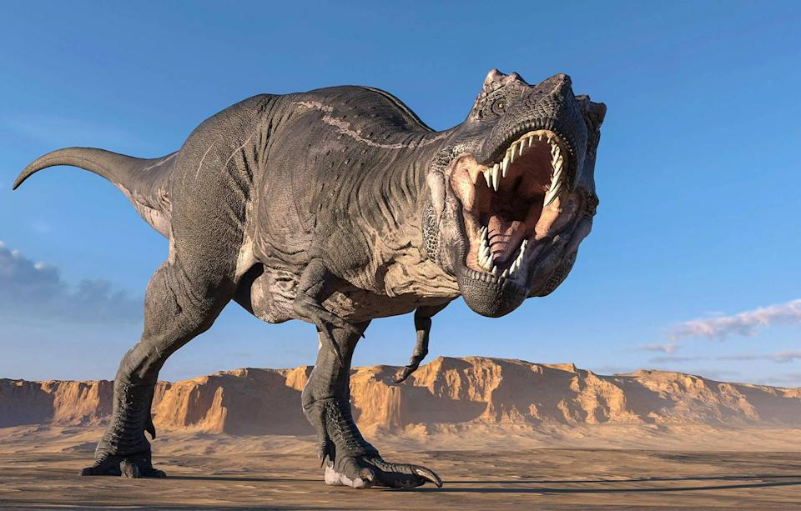
Demonstration

